Slide 1

PROJECT TITLE : OTT PLATFORM / ONLINE MOVIE LIBRARY SYSTEM
TEAM Members ROLL NO.
1.ThanuSree 2510040112
2.Pranavi 2510030336
3.Siri 2510030225

Slide 2
Project Overview:
This project simulates a basic OTT platform like Netflix or Prime Video
It allows users to:
View available movies
Search movies by ID, Name, and Genre
View trending movies
Maintain watch history
Manage watch list
The system is menu-driven and user interactive
It demonstrates real-world application of data structures
(The project focuses on efficient data handling using different data structures)

Slide 3
Key Features of the System :
→Provides a simple and user-friendly menu-driven interface for easy interaction
→Displays detailed movie information including ID, Name, Genre, Ratings, and Views
→Allows users to search movies based on Movie ID, Movie Name, and Genre Code
→Includes a Trending Movies section where movies can be added, removed, and viewed dynamically
→Maintains a Watch History to keep track of previously watched movies
→Provides a Watch List feature where users can add, remove, and view movies
→Supports sorting of movies based on ratings, views, and alphabetical order

Slide 4
Working of the System :
-User selects options from the menu
-Movies are displayed from the array
-Searching is performed based on user input
-Trending movies are managed using Queue:
New movies added → Enqueue
Old movies removed → Dequeue
-Watch History:
Movies added and deleted dynamically using Linked List
-Watch List:
Movies added and removed using Stack operations
-Sorting feature arranges movies based on user preference
(The system ensures organized and efficient movie management )

Slide 5
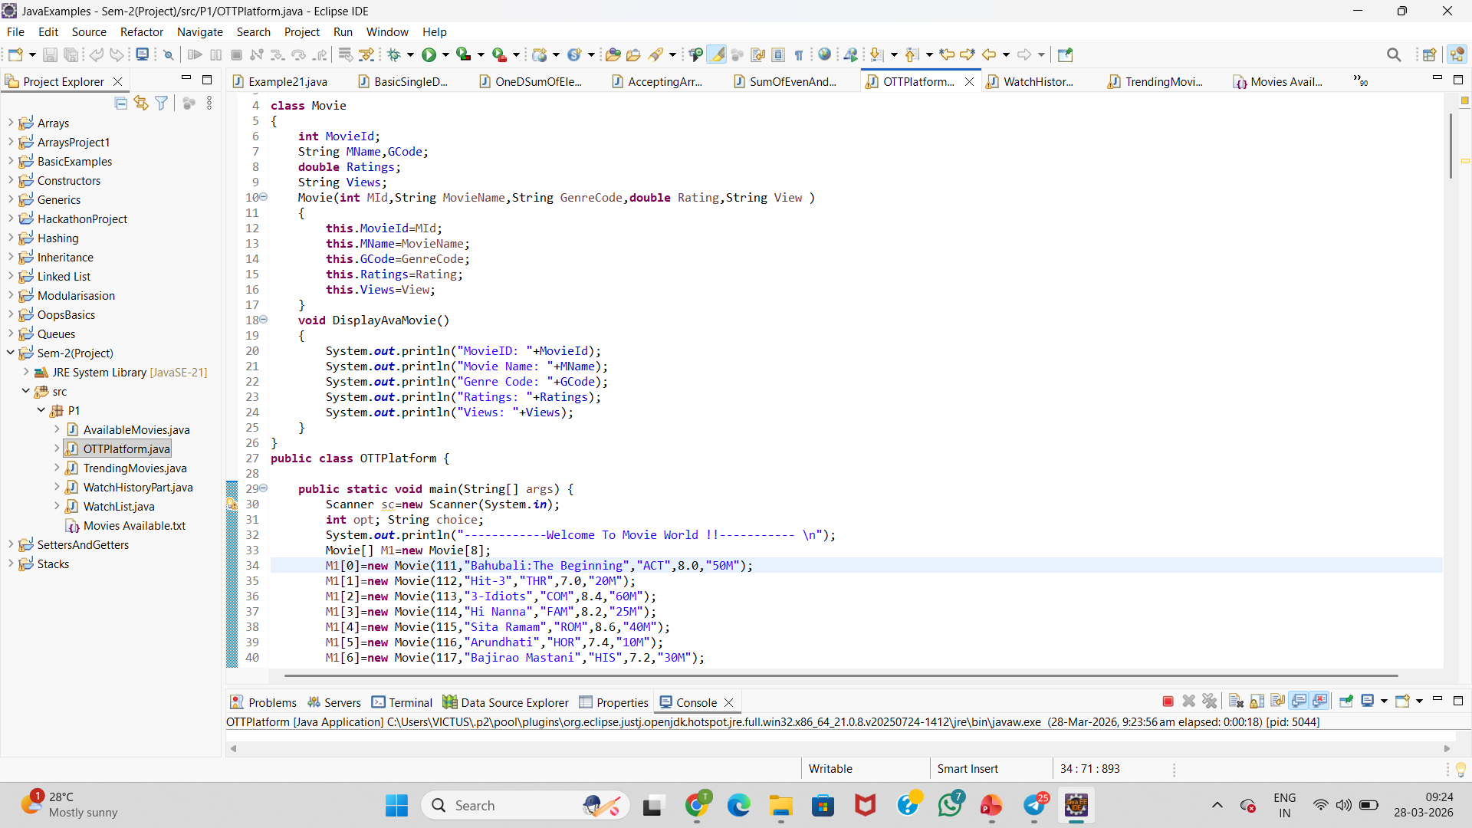
ARRAYS :
Arrays are used to display the movies and the movie details like number of views, ratings, genre code .

Slide 6
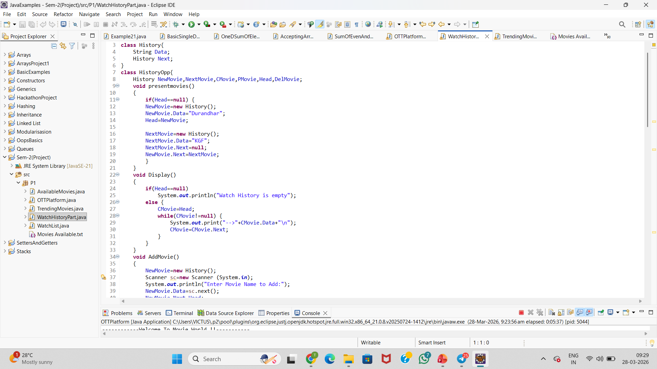
LinkedList : LinkedList is used for watch history in which user can delete user choices movie and even add movies which he has watched

Slide 7
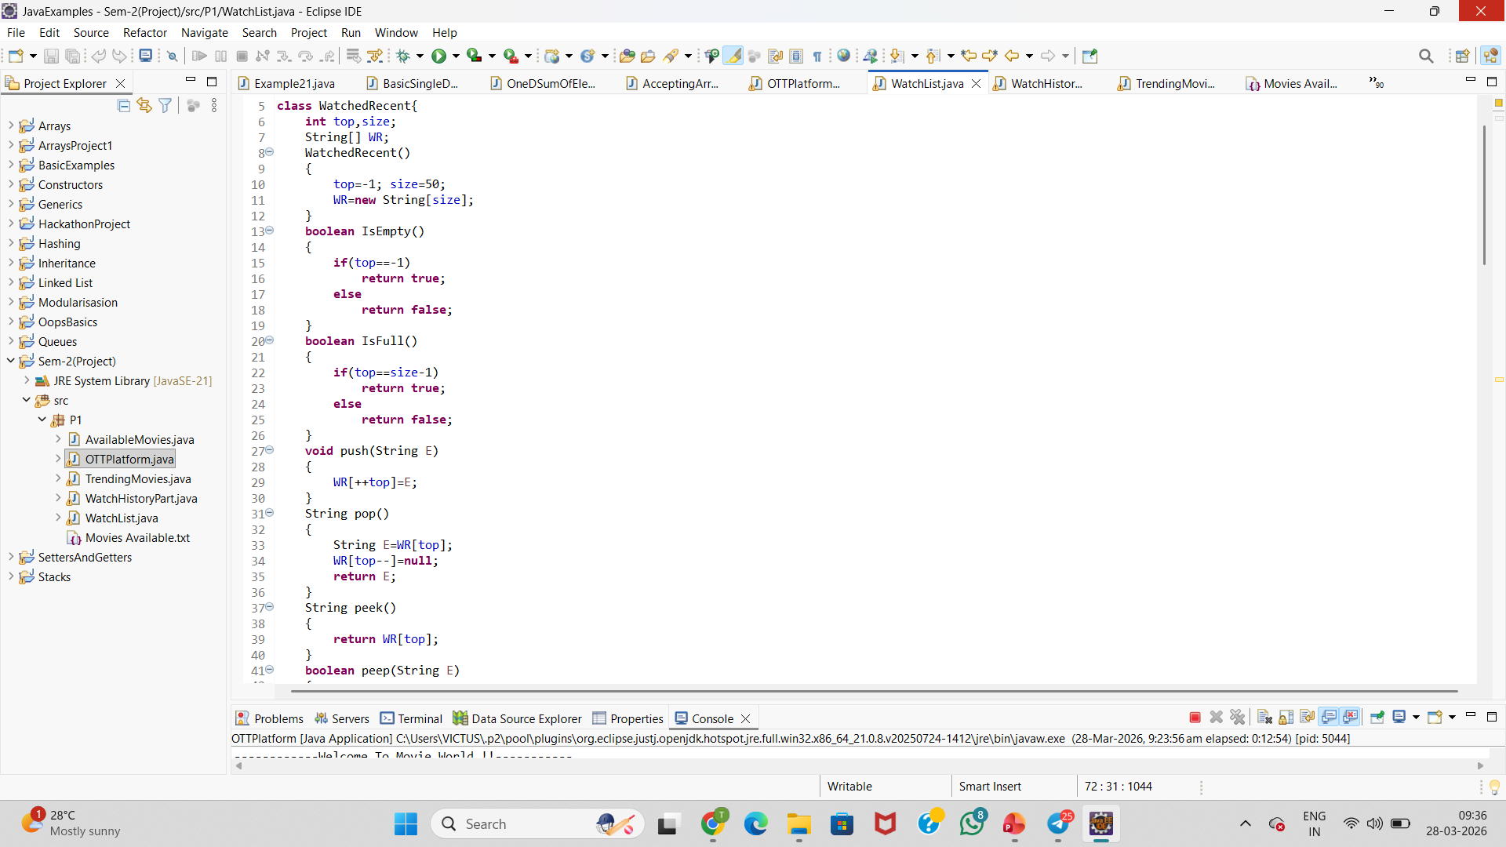
Stacks : Stacks are used for watch List in which user can add movies to the watch list to watch later and can also delete watched movie and can search the movie in the watch list

Slide 8
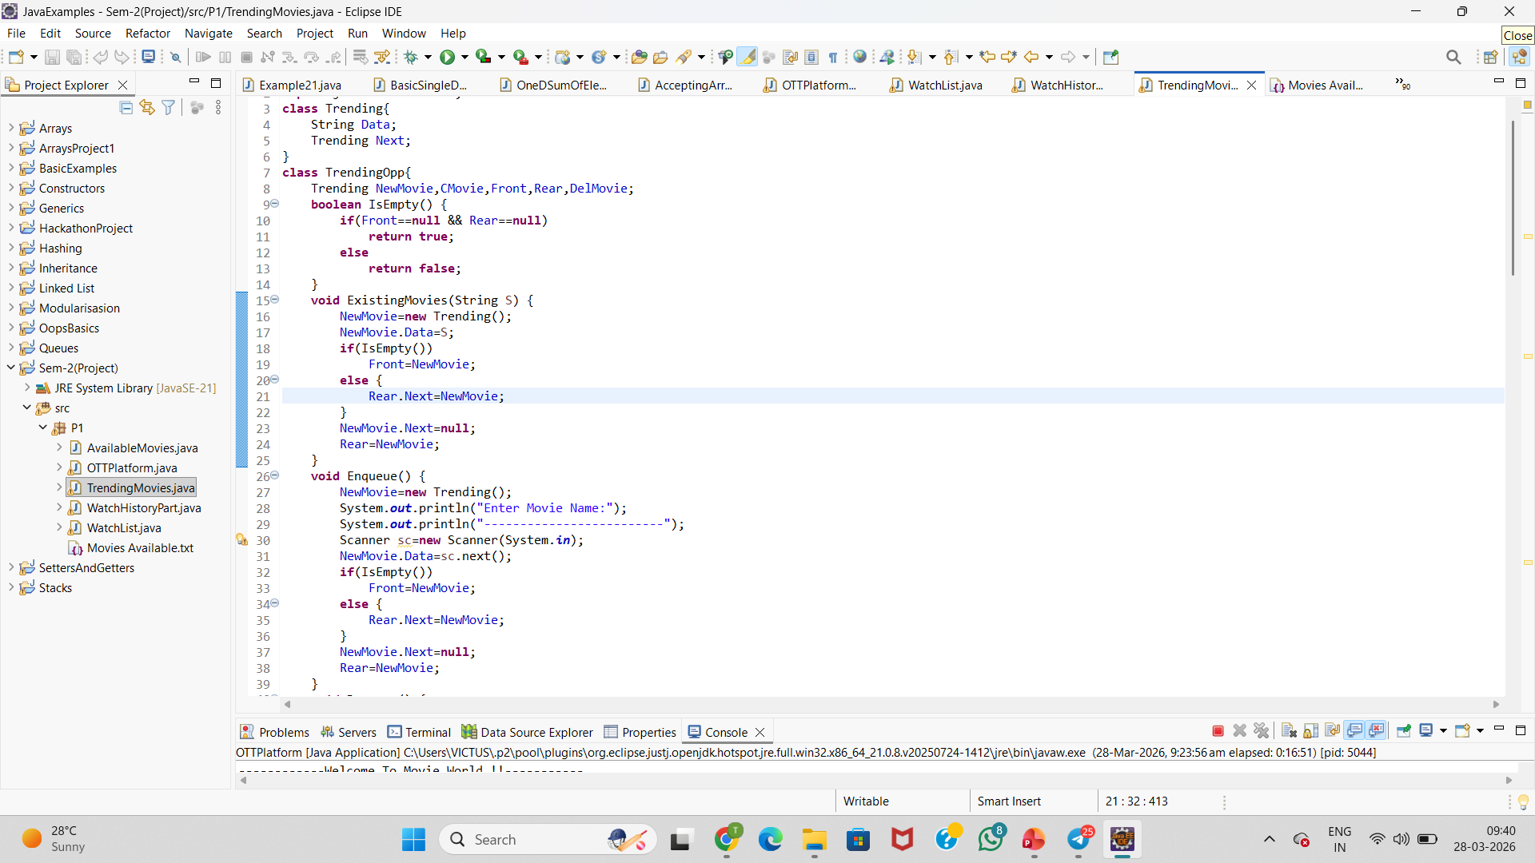
Queues : Queues is used for trending movies as it uses first in last out (FILO) and last in first out (LIFO) .In this user can see trending movies and can delete then and even add movies.

Slide 9
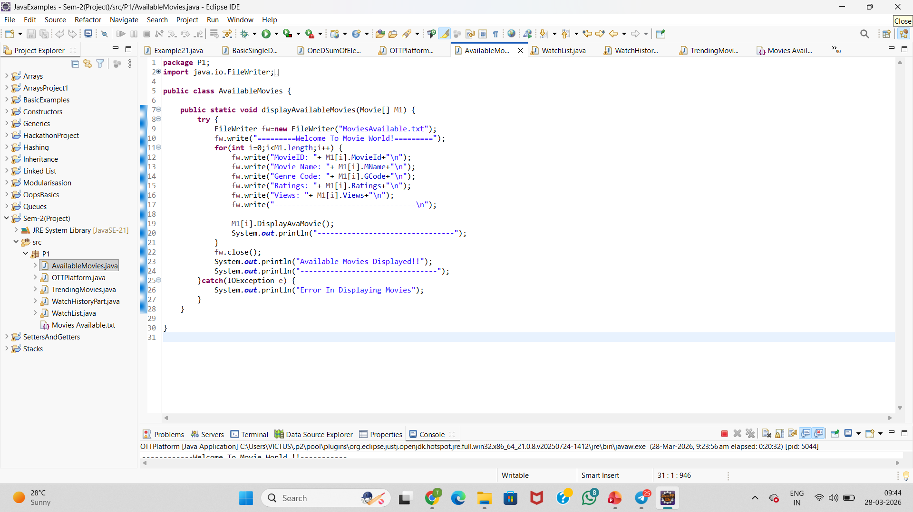
File Handling : In this file handling is used to store the Movie Details which can be edited also

Slide 10
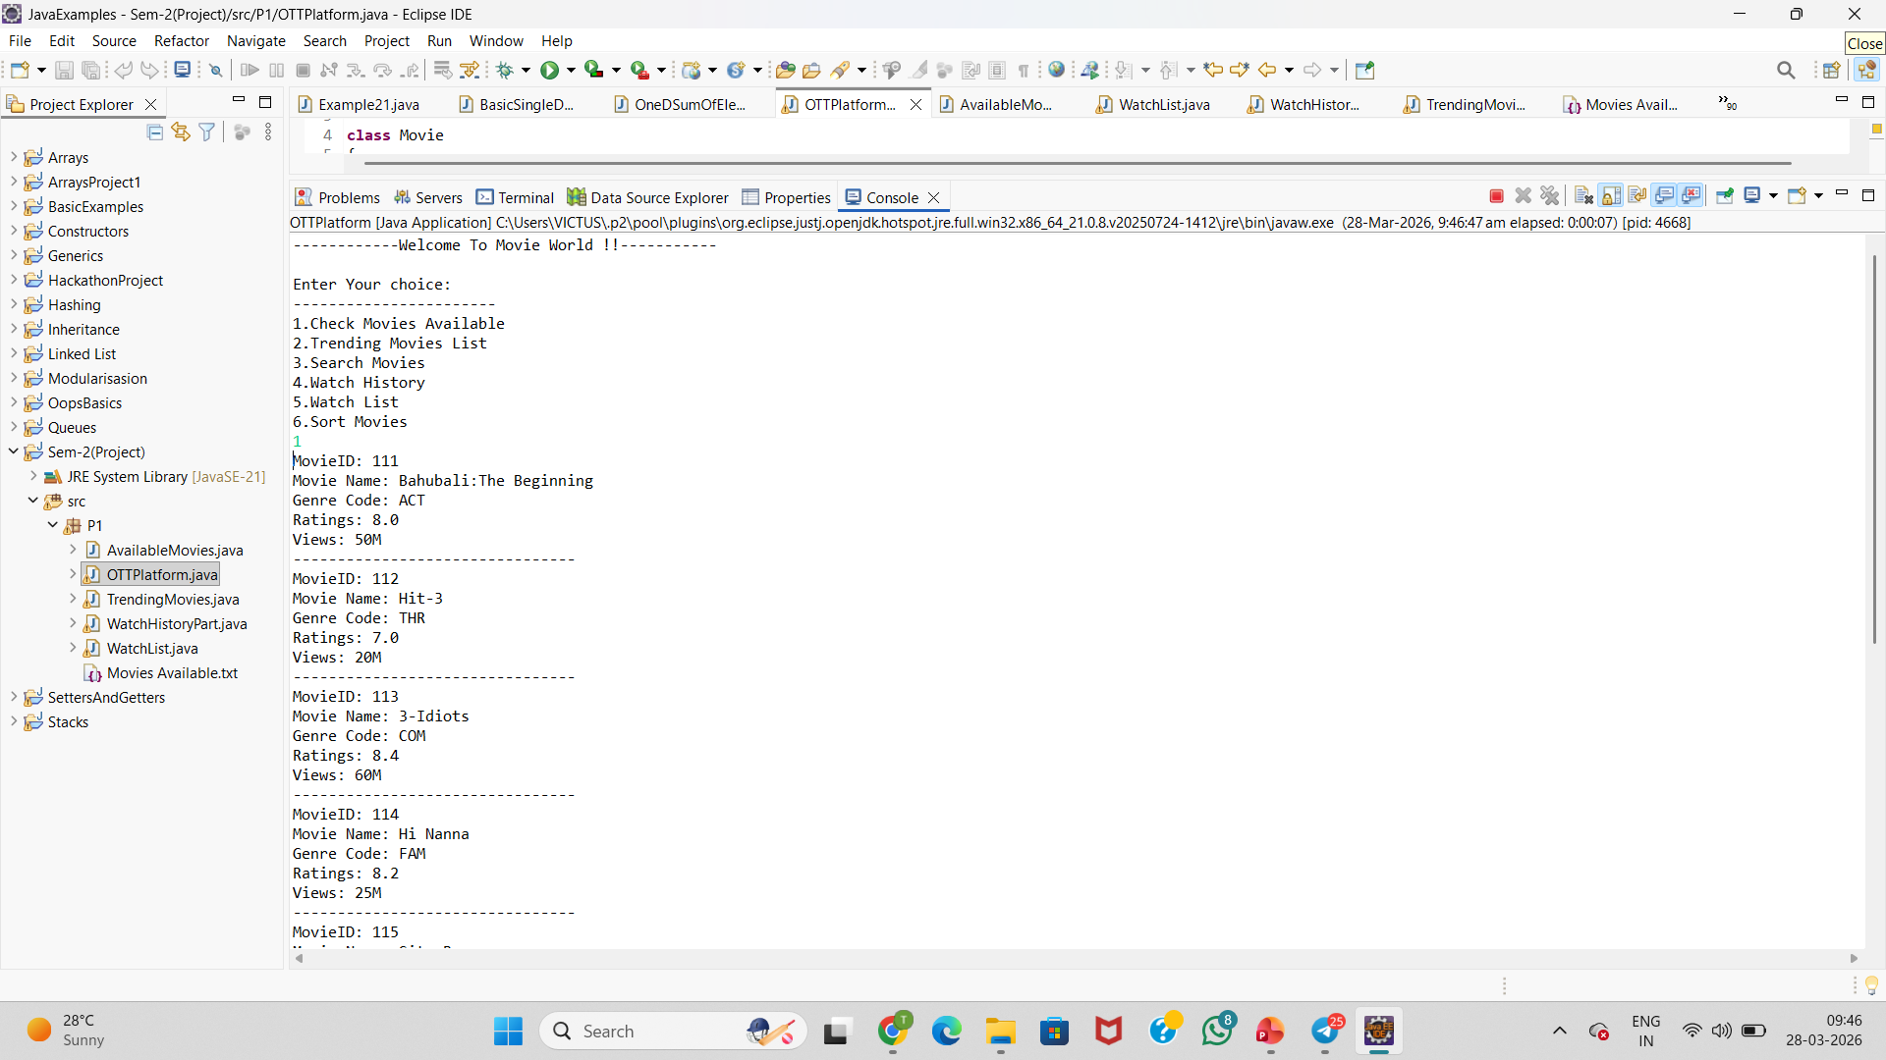
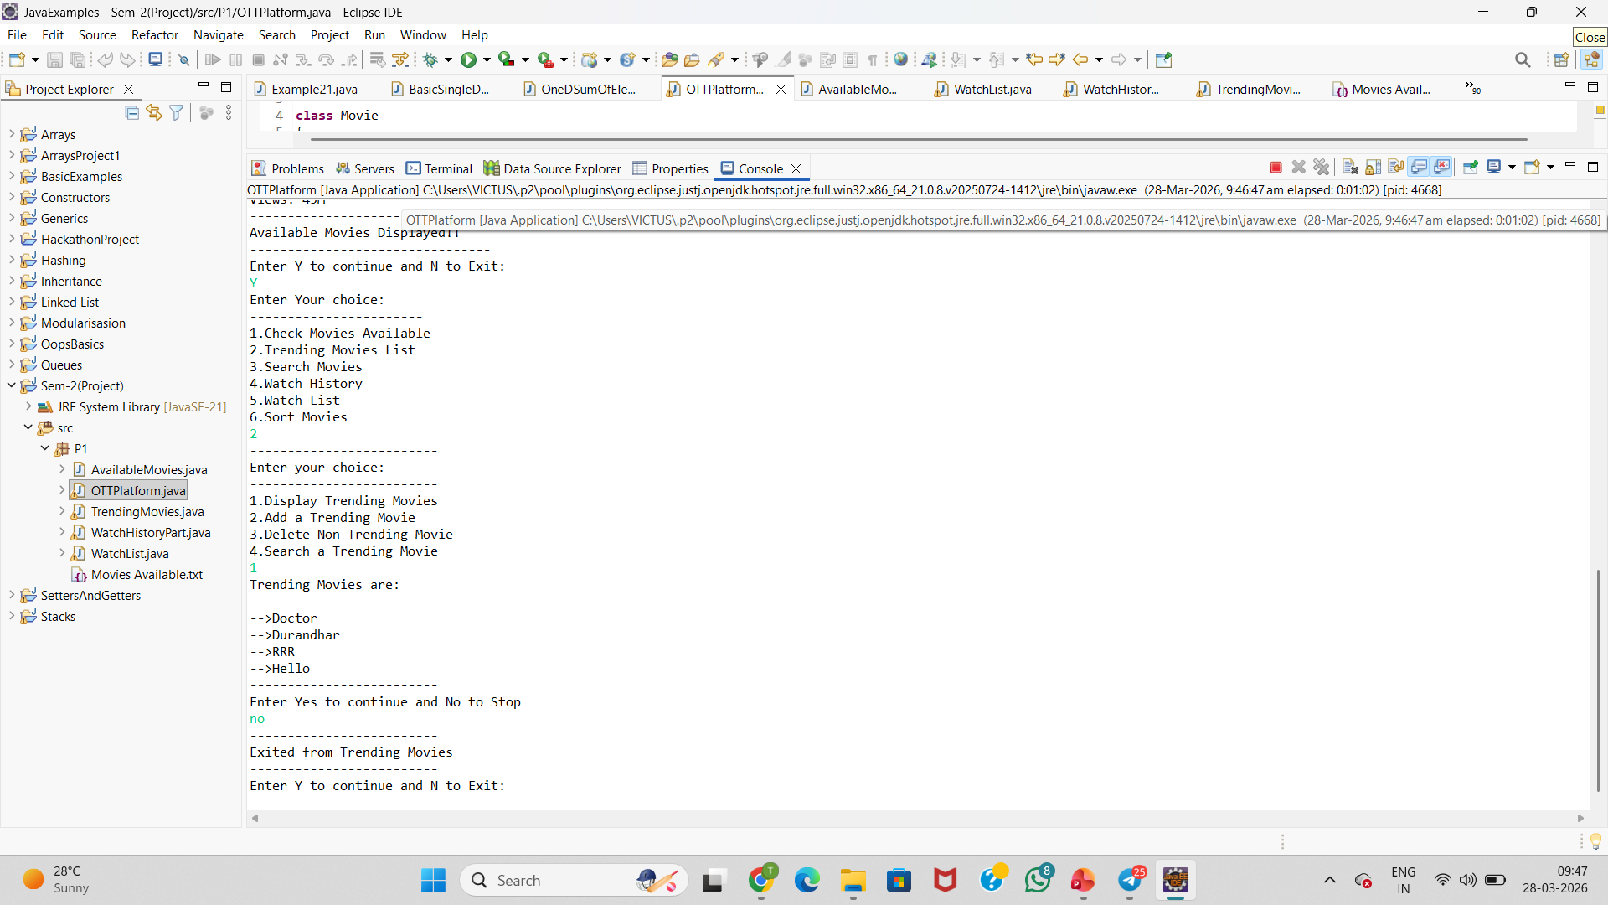
Output : These are the 2 samples output structure of the code

Slide 11
Thank You !

